Slide 1
A Research Paper
Rohit Seth, Ph.D.

Slide 2
What is a Research
Paper?
Document of scientific findings.
Scientific papers are the heart of the scientific community.

Slide 3
A research paper is an expanded essay that presents ones interpretation or evaluation or an argument.
When anyone write’s a research paper they build upon what they know about the subject and what other experts know.
A research paper involves surveying a field of knowledge in order to find the best possible information in that field.

Slide 4
What are the areas in which one can publish a research papers?
Science
Arts
Humanities
Religion
Management
Language etc.

Slide 5
What is the essence of a science publication?
Science is
  Public
  Objective
  Predictive
  Reproducible
  Systematic
  Cumulative
Publication makes this possible
  Final step in discovery

Slide 6
EXAMPLE
BIOMEDICAL RESEARCH

Slide 7
Why should I read?
  To find out whether to use a (new) diagnostic test or treatment
  To learn clinical course and prognosis of a disease or treatment
  To determine etiology & causation
  To distinguish useful from useless (or harmful) therapy

Slide 8
Interpretation
Body of a research paper
  Introduction
  What question was studied?
  Methods
  How was the question studied?
  Results
  What was found?
  Discussion
  What do the results mean?

Slide 9
Other parts of a paper
Additions
  Title, authors, affiliations
  Abstract
  Subsections
  Tables & figures
  References
  Acknowledgements & disclosures
  Appendices
  Electronic supplements

Slide 10

How do I read a research paper?

Slide 11
Read a scientific paper as a critic
Understand the problem
Understand the proposed solution
Understand competing approaches / designs
Evaluate the paper
Peer review is the cornerstone of the scientific publishing process

Slide 12
Evaluating a Paper
What is the problem being solved?
  Is it important? Relevant? Why?
  What is the prior work in this area?
Is the proposed solution clever?
  Cleverness is orthogonal to importance!
Are the assumptions and model reasonable?
Impact
  Easier to evaluate for older papers
  Does other work build on it? Do other papers uses techniques and solutions proposed in this paper?

Slide 13
Evaluation Process
Read slowly, take notes as you read
  Question assumptions, importance of the problem
  Write questions to track what you don’t understand
Sometimes what is not in the paper is more important than what is in it
  Is there something the authors have overlooked?
Don’t let ideas or design details pass until you understand them!
Do not assume the paper is correct, even if published in a prestigious peer-reviewed venue

Slide 14
Ground Rules
Try to understand
Don’t be afraid to ask
Be constructive
Be polite
Don’t be afraid to criticize (constructively!)

Slide 15
Two Types of Scientific Papers Containing Two Types of Information
Review articles: give an overview of the scientific field or topic by summarizing the data and conclusions from many studies.
Primary research articles: contain the original data and conclusions of the researchers who were involved in the experiments and how the experiments were done.

Slide 16
First read the abstract in order to understand the major points of the work.
It clarifies whether you in fact know enough background to appreciate the paper.
It refreshes your memory about the topic.
It helps you as the reader to integrate the new information.

Slide 17

Continue…
Introduction can be skimmed.
The logical flow of papers goes straight from the Introduction to Results.
Then to Discussion for interpretation of the findings.
This is only easy to do if the paper is organized properly.

Slide 18
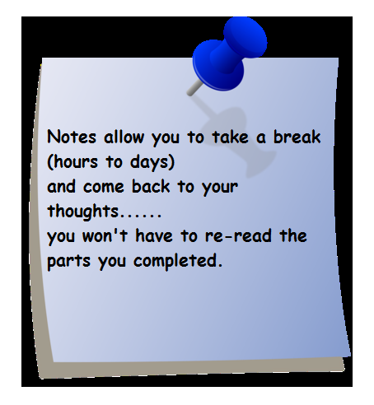
How to read the results…
Examine the figure
take notes
with each experiment/ figure you should be able to explain:
The basic procedure
the question it sought to answer
The results
the conclusion &
Criticism

Slide 19

How to read a discussion
Take notes and answer these questions:
What conclusions did the authors draw?
Opinion/ interpretation?
Ask yourself why is this data significant?
Does it contribute to knowledge or correct errors?

Slide 20

By now, you may be tired of this paper…
But don’t relax yet…
save energy for the overall reflection and criticism.

Slide 21
Reflection and Criticisms
Do you agree with the authors’ rationale for setting up the experiments as they did?
Did they perform the experiments appropriately?
Were there enough experiments to support the major finding?
Do you see trends/patterns in their data?
Do you agree with the author’s conclusions?
What further questions do you have?
What might you suggest they do next?

Slide 22
Reading a scientific paper
Struggle with the paper
  Active not passive reading.
  Use highlighter, underline text, scribble comments or questions on it, make notes.
  If at first you don’t understand, read and re-read, spiraling in on central points.
DO NOT highlight whole sentences or paragraphs

Slide 23
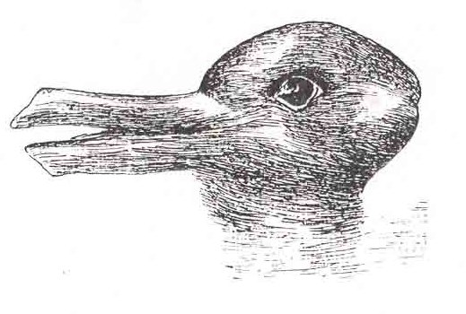
The famous duck-rabbit ambiguous image.
When one looks at the duck-rabbit and sees a rabbit, one is not interpreting the picture as a rabbit, but rather reporting what one sees.

Slide 24


Slide 25
MEDICAL WRITING

Slide 26
The Medical Writer
The best preparation for writing scientific papers is to
  Write papers as a time and lifetime priority
  Respond responsibly to referees’ reviews of your paper
  Referee papers—become a reviewer, editorial board member, maybe even an editor!

Slide 27
Doctors as Writers
Write a scientific paper like you would take care of a patient having a procedure
  Preprocedure preparation
  Goals (patient care plan)
  Sequence of procedure
  Postprocedure care

Slide 28
Best Preparation for Writing
A good protocol for study in the first place!
  Important question / hypothesis
  Clear set of objectives to answer question
  Analyses organized by these objectives
See reporting template…

Slide 29
Writing Order
Preparation
  Review materials, methods, results
Goals
  Establish paper’s message & audience
  Select purposes tied to message
Sequence
  Finish methods & results
  Discussion, introduction, references
  Definitive title & authors
Post-writing
  Out to co-authors & revise
  Revise (seriously) after journal review

Slide 30
Get Down to Business!
Section-by-Section
Overview
What to Look For

Slide 31
Title
What is paper about?

Slide 32
Title
Introduces the work
First thing read
  Usually it is ONLY thing read
Serves to entice intended readers

Slide 33
Title
How do you evaluate a title?
Characterize a good title

Slide 34
Title
Characteristics of good titles
  Short, but specific (not an abstract!)
  Truly represents content
  Might…
    Be provocative or controversial
    Ask a question
    Make statement of conclusion
  Indexable
Avoid
  Qualifiers, jargon, abbreviations, filler

Slide 35
Title
Evaluation
  Does title tell you what paper is about?
  Does it overstate contents?
  Is it too bland to entice readers?
  Is it “too cute”?
  Does it mislead?

Slide 36
Authors
Who wrote this?

Slide 37
Authors
Why are authors important?
Who should write the paper?
Who should be on author list (if any)?
  How many?
  What order?
  What roles?

Slide 38
Authors
Why important?
  Like it or not, it is an issue of authority or expertise or experience (sociology)
Where was work done?
  Credibility
  Generalizability
  Assists evaluating apparent negative results

Slide 39
Authors
Controversies
  Who should be an author?
  Number of authors
  Author order
  Conflicts of interest / disclosures
Subject all its own…

Slide 40
Authors
Evaluation
  “This paper suffers from lack of input, guidance, and expertise from the senior authors”

Slide 41
Ultra-Mini Abstract
What is the essence of this study—the “take home” message?

Slide 42
If reader is interested…
Robert Day
  Clearly stated problem
  Clearly stated conclusion
Steven Laureys
  Develop a central message and write everything else to support it
JWK / EHB
  Ultramini Abstract: essence of findings for writer and reader

Slide 43
Ultramini Abstract
For readers
  Scanning tool
For authors (~3 hour’s effort)
  Best preparation for writing paper—the roadmap!
Content
  Truest 1-3 sentences (~50 words) about the essence of the study—its message—its inferences

Slide 44
Ultramini Abstract
Evaluation
  Analogous to the “elevator pitch” for a business
  It is not a summary of study purpose or results
  It is congruent with conclusions of abstract and paper
  It is hard work
  It is often done poorly

Slide 45
Abstract
Should I read the article?

Slide 46
Abstract
Meeting abstract
  Purpose: to get on program
Paper abstract
  Summarizes information and data contained in more complete form in IMRD aspects of manuscript
  States conclusions (“bottom line”)
  Self contained
  #2 item read (after title)

Slide 47
In fact…
For most readers reading selectively and strategically
  Skim first line to understand problem addressed
  Skim last line for conclusions
No sense
  Concluding by merely again summarizing results that have already been summarized!

Slide 48
Abstract
Evaluation
  If not structured, read it in structured fashion
  Are purposes clearly stated?
  Do conclusions match 1:1 the purposes of study
  Do methods clearly tell me the study group (e.g. animals, patients)?
  Is there supporting data for each stated purpose & conclusion?

Slide 49
Introduction

Slide 50
Introduction
What I like
What I hate
What should it accomplish?

Slide 51
Introduction
What is the Problem?
Why is it Important?
What is the Approach?

Slide 52
Introduction
4 short segments
  Problem statement
    Does not review field
  Why is it important?
  What is context?
  Purpose of study
    Sets complete roadmap for paper
    Slavishly followed in order and with same words for rest of paper

Slide 53
Introduction
What reader reads (if at all)
  First sentence or two
  Last sentence or two

Slide 54
NIH Illustration
7,000 patients will be diagnosed with esophageal cancer this year…
It is a killer…
Its location differs around the globe… Staging system is not data-driven…
Cause is unknown, but environment may play a role. For example…
Barrett esophagus is widely thought to be a precursor… Tums and pizza…
Therefore, we investigated cell signaling related to transformation of squamous epithelium to columnar configuration in nude knockout mice.

Slide 55
Alternative First Sentences
Discovering the cell signaling by which esophageal epithelial cells transform into columnar configuration by gastric acid reflux may lead to better understanding of the pathogenesis and possible prevention of esophageal cancer…

Slide 56
Introduction
Evaluation
  Does it rapidly tell me where this paper is headed?
  Can it be better focused (“boiled and distilled”)?
  Does it make a case for itself?
  Are we talking people or animals?
  Are purposes clearly laid out AND does the author follow the map?

Slide 57
Materials and Methods
How was the study done?
Should I believe this study?

Slide 58
Materials & Methods
For selective, strategic readers
  Rarely read in entirety if at all
  Assumes this section has been vetted by peer review process
For reviewers
  Inadequacies often identified
For science
  Is study valid?
  Is it replicable?

Slide 59
Materials and Methods
If patients (for example)
  What was done?
  Where?
  Time frame?
  Context?
  Inclusion/exclusion criteria?
  How many (CONSORT diagram)?
  Characteristics of patients?

Slide 60
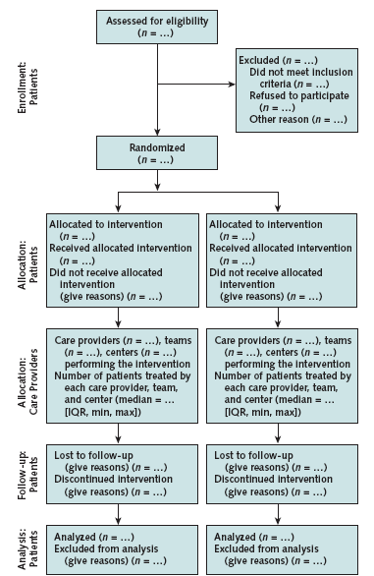
CONSORT Flow Diagram
How was study group assembled?
  Base group included
  Specific exclusions
  Analysis group

Slide 61
Materials and Methods
Intervention
  Details
  Study protocol

Slide 62
Materials and Methods
End points
  Define (eg, all-cause mortality)
If patient follow-up
  Passive vs. active
  Systematic (vs. opportunistic)
    Anniversary
    Cross-sectional
  Completeness

Slide 63
Materials and Methods
Data analysis
  Organize according to purposes of study
  Provide detail or references to technical methodology
  BUT don’t leave loopholes!
    Most common error is not listing variables considered in analyses

Slide 64
Materials and Methods
Presentation
  Format of summary statistics
  Confidence limits & level
  Other special features of presentation

Slide 65
Materials and Methods
Evaluation
  A checklist is valuable for authors, evaluators, and readers
  CONSORT is one, but journals may have their own
  Often contentious
    Old methods
    Unfamiliar methods
    Complex methods

Slide 66
Results
What was found?

Slide 67
Results
What do you look for?
What should be there?
What shouldn’t be there?

Slide 68
Results
Often read selectively and strategically
  Figures looked at the most—even though they are the first thing reviewers suggest eliminating
This is core of paper

Slide 69
Results
What results should be shown?
  Selected, well-digested data & findings
  Relate directly to purposes of paper, organized according to purposes, using identical words
  No interpretation
  No repetition of text, tables, figures

Slide 70
Results
Part of the truth
  Not the whole truth
Themes
  Accuracy
  Brevity
  Clarity
Future
  Repository of raw data for reanalysis

Slide 71
Results
Evaluation
  Are data presented that convincingly support conclusions?
    Logical pieces all there
    Results stated accurately
  Are there appropriate expressions of uncertainty?
  Do negatives reflect underpowered study?
  Are methods mixed with results?

Slide 72
Results
Evaluation
  Tables
    Appropriate
    Complete for their purpose
    Statistically sound
  Figures
    Appropriate information content
    Complete legend
    Readable

Slide 73
Discussion

Slide 74
Discussion
What I like
What I hate
What is purpose?
What order?

Slide 75
Discussion
So what?
Who cares?

Slide 76
Discussion
Failure
  If the reader finishes discussion and wonders “So what?”

Slide 77
Discussion
What do results mean?
  Interpretation
  Relationships among results
  Generalizations
  Theoretical implications

Slide 78
Discussion
What do results mean?
How do they relate to cumulative knowledge?
  Support
  Contradict
  Completely new
How should I use them?
  Practical application

Slide 79
Discussion
Suggested outline
  Summarize findings (controversial)
  Principal findings
    Organized by purpose-driven roadmap
    Put results in context of others
  Limitations
  Conclusions
    inferences
    Recommendations

Slide 80
Discussion
Evaluation
  Is it concise and focused strictly on purposes of study?
  Is interpretation of study reasonable?
  Have others been quoted and represented accurately?
  Are inferences supported by results?
  Is speculation identified?
  Are there promissory notes?
  Are new results presented?

Slide 81
References
Can I verify claims and arguments?

Slide 82
References
Not exhaustive
  30 or less is sufficient
  Not just recent literature
Contextual
  Place subject in context
  Represents all sides of controversy
  Truly relevant
Cited accurately
  NLM has a problem!

Slide 83
Summary
Science = publication
Format stereotyped (signposts)
Readers selective and strategic
  They rely on reviewers to vet scientific validity
Conclusions (message) key
  May have life-and-death implications—and more
Impact of use unstudied!

